Slide 1
Biology: Classification
Year 7 Science

Slide 2
Review:
M
R
S
G
R
E
N

Slide 3

Using MRS GREN
Is fire alive?
So living things must MRS GREN and contain cells.

Slide 4
Learning Intentions
There are differences within and between groups of organisms; classification helps organise this diversity.

Slide 5
Success criteria
Explain why we need a system to classify
Use a scientific name for some species
Make an acronym for KPCOFGS

Slide 6
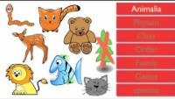

Slide 7
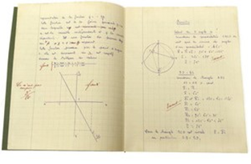
Classification system 6/03/2024
Kingdom
Phylum
Class
Order
Family
Genus
Species

Slide 8
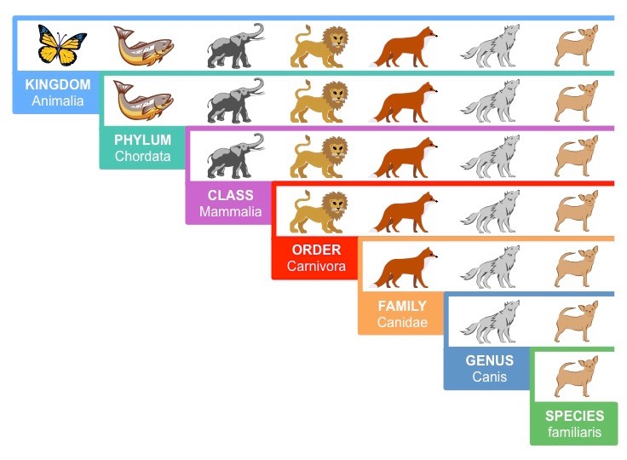

Slide 9
Scientific names 6/03/2024
Common name | Noongar name | Scientific name

Slide 10
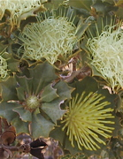
Parrot Bush budjan
Banksia sessilis

Slide 11
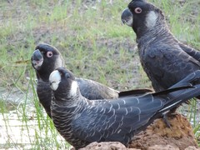
Carnaby’s Cockatoo ngoolark
Zanda latirostris

Slide 12
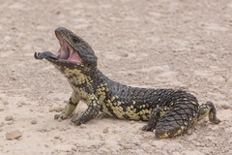
Shingleback “bobtail” lizard yoorn
Tiliqua rugosa

Slide 13
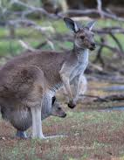
Western grey kangaroo yongka
Macropus fuliginosis

Slide 14
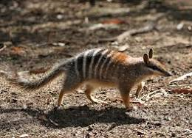
Numbat noombat
Myrmecobius fasciatus

Slide 15
Success criteria
Explain why we need a system to classify
Use a scientific name for some species
Make an acronym for KPCOFGS

